Slide 1
Artificial & Computational Intelligence DSE **ZG557
Uninformed Search
Manickam.M

Slide 2
Uninformed Search
Manickam.M

Slide 3
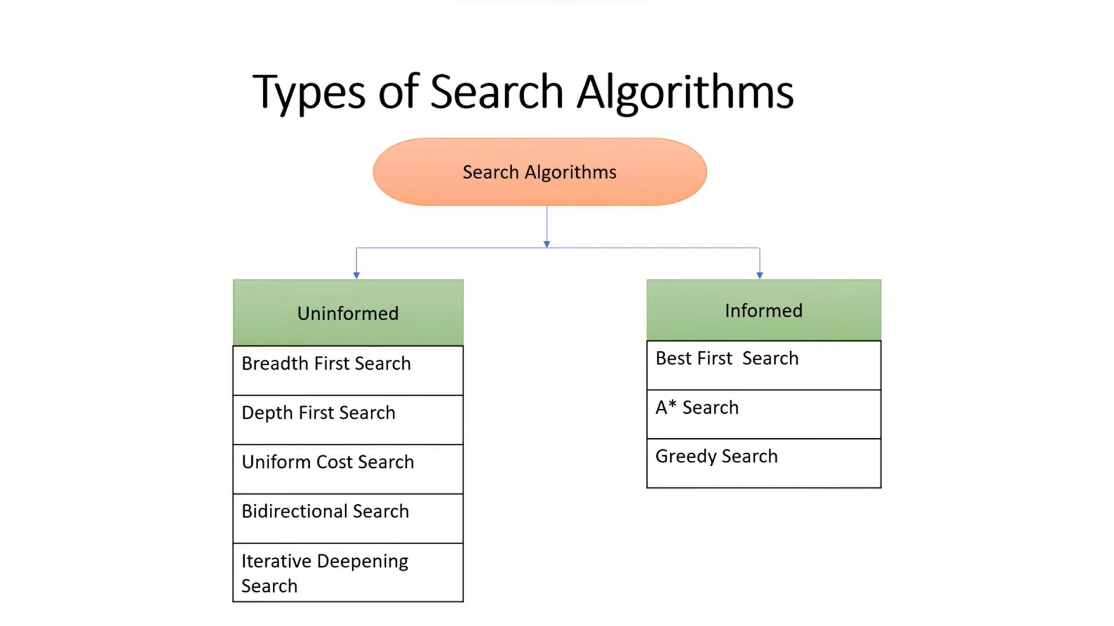

Slide 4
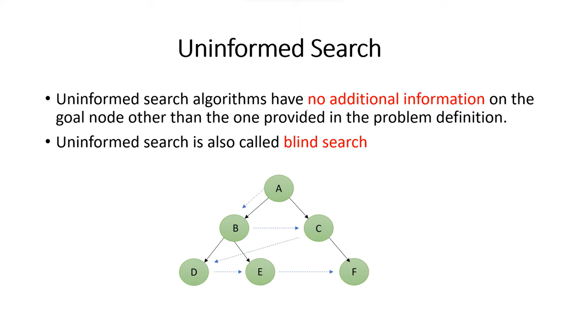

Slide 5
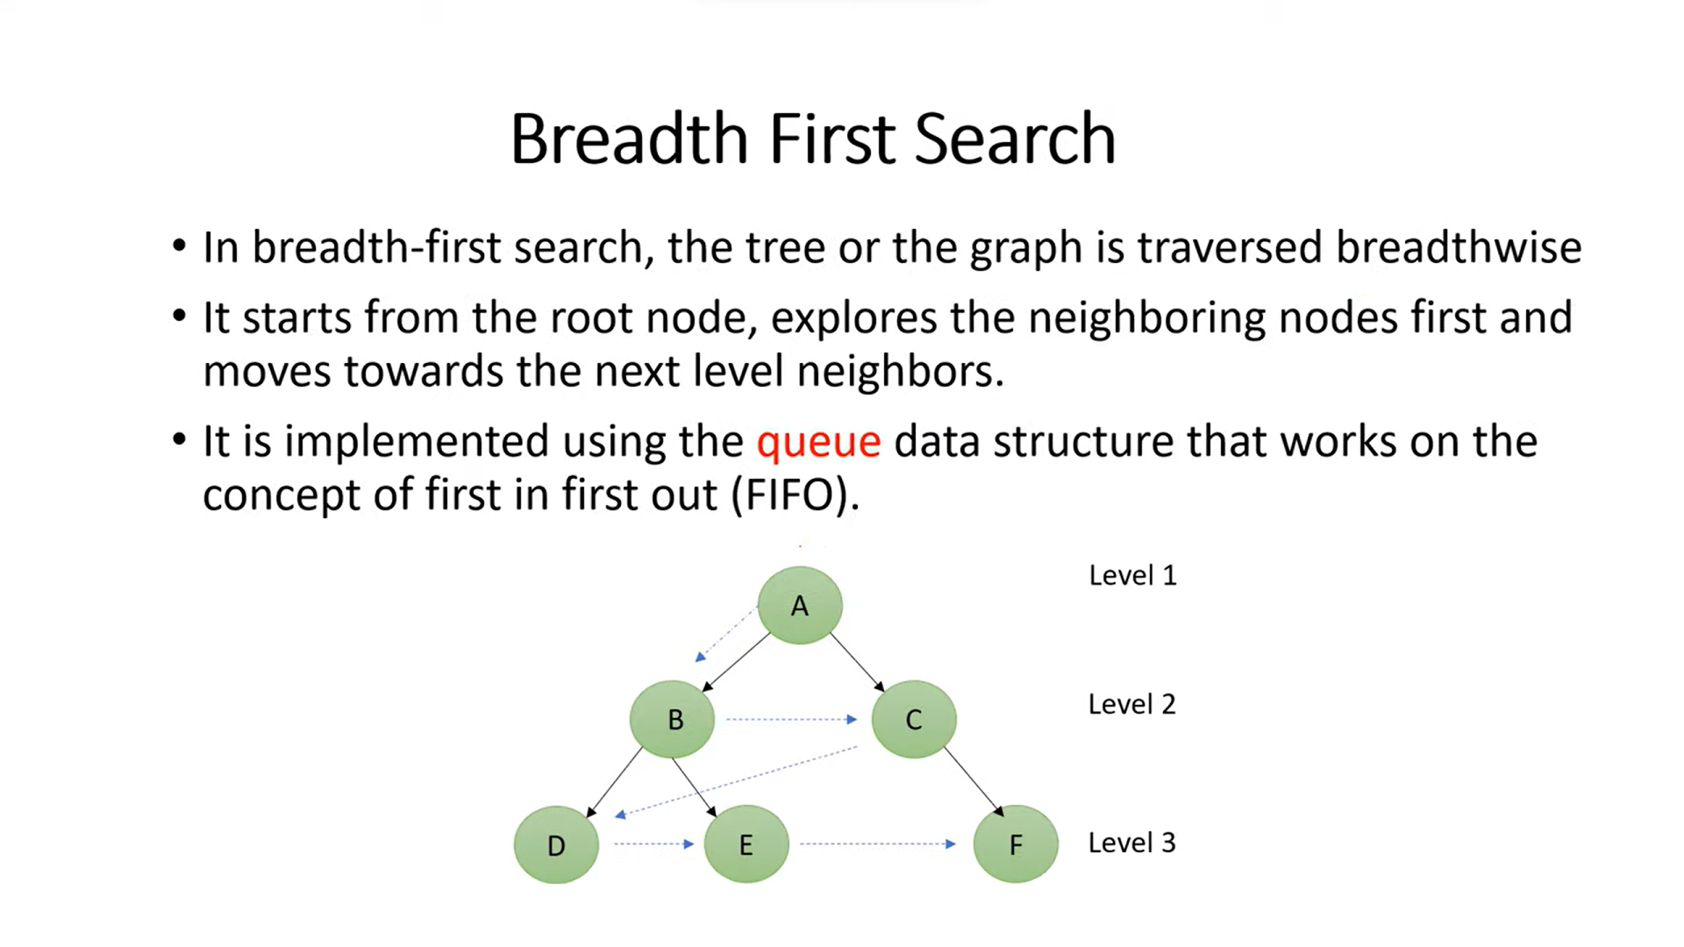

Slide 6
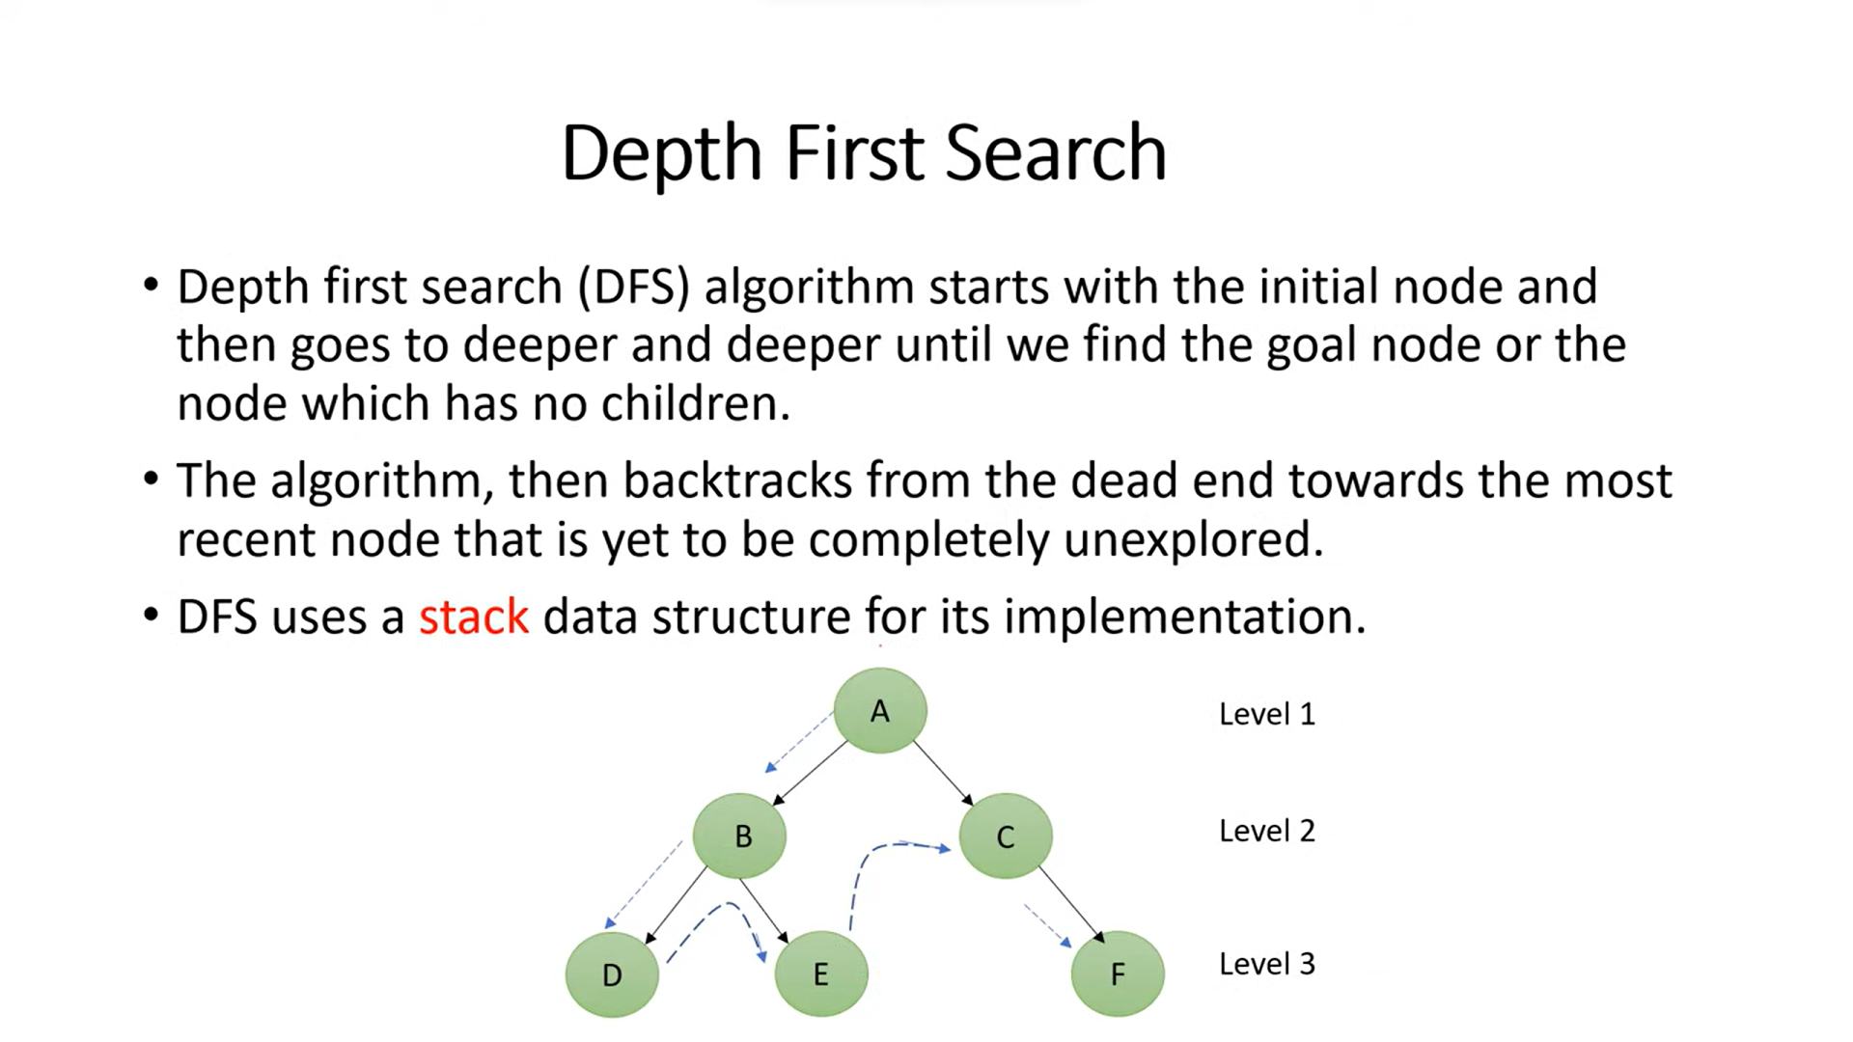


Slide 7

Problem Formulation
A binary maze is an n*m matrix where,
maze[i][j] = 1 represent traversable blocks
maze[i][j] = 0 represent obstacles.
Given the binary maze with obstacles and traversable blocks as represented in the next slide, find the optimal path between a source cell and destination cell.
Permissible moves are north, south, east and west (up, down, right, left)

Slide 8

Problem Formulation
Input : Binary matrix, source indices, destination indices
Input
Binary Matrix:
inputMaze= [[1, 1, 1, 1, 1, 1, 1, 1], [1, 1, 1, 1, 1, 1, 1, 1], [1, 1, 1, 1, 1, 1, 1, 1], [1, 1, 0, 0, 0, 0, 0, 1], [1, 0, 1, 1, 1, 1, 1, 1], [1, 1, 0, 1, 1, 1, 0, 1], [1, 1, 1, 1, 1, 1, 1, 1]]
src = [0, 0]
dest = [2, 2]
Logic / Search Technique: DFS/BFS
Output : List of tuples representing path from source from destination

Slide 9
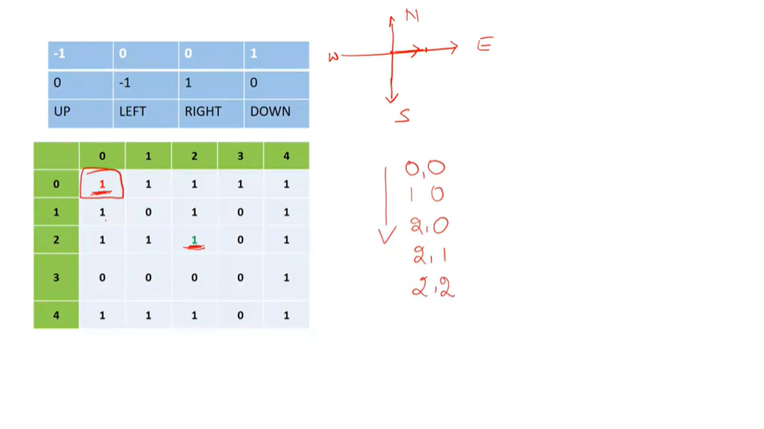

Slide 10
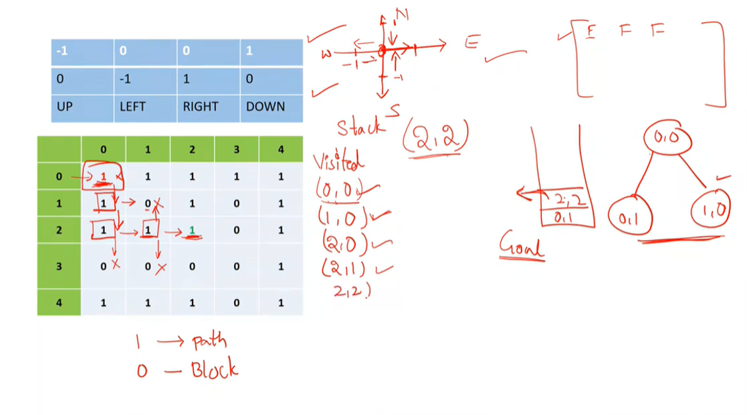





Slide 11
-1 | 0 | 0 | 1
0 | -1 | 1 | 0
UP | LEFT | RIGHT | DOWN
 | 0 | 1 | 2 | 3 | 4
0 | 1 | 1 | 1 | 1 | 1
1 | 1 | 0 | 1 | 0 | 1
2 | 1 | 1 | 1 | 0 | 1
3 | 0 | 0 | 0 | 0 | 1
4 | 1 | 1 | 1 | 0 | 1

